Slide 1


Digital Marketing Agency
6th Semester
CT606-N Project-I
Computer Engineering
Group No:02
Internal Guide:
Prof. Krupali Dave
Prepared By:
Patel Dhyan Jayeshkumar (223SBECE54021)
Patel Shreyaben Hemendrakumar (223SBECE54032)
Patel Vaishvi Kamleshkumar (223SBECE54033)
Satasiya Bansari Rakeshbhai (223SBECE54038)

Slide 2
Outlines
Introduction
Problem Statement
Objective
Scope
Possible Outcomes
Flowchart Diagram
E R Diagram
DFD Diagram
Final Prototype
Implementation
Videos
Conclusion & Future Works
References

Slide 3
1.INTRODUCTION
In today’s fast-paced digital age, businesses need innovative strategies to stay ahead in the competitive landscape. Hashtaghub, a cutting-edge digital marketing agency, is designed to meet these challenges by offering comprehensive and customized digital marketing solutions.
Specializing in areas such as social media marketing, content creation, search engine optimization (SEO), and data-driven advertising campaigns, Hashtaghub leverages the power of technology to help brands thrive in the digital ecosystem. The agency’s mission is to enhance brand visibility, foster engagement, and deliver measurable growth for clients across various industries.
Hashtaghub stands out by emphasizing creativity, analytics, and a customer-centric approach, ensuring that every campaign resonates with the target audience while achieving the desired objectives. This project report explores the agency’s strategic framework, core services, and the innovative methodologies that set it apart in the competitive digital marketing industry.

Slide 4
2.Problem Statement
In an era dominated by digital interactions, businesses often face significant challenges in navigating the complexities of the online ecosystem. The lack of effective digital marketing strategies, limited access to data-driven tools, and the inability to adapt to evolving consumer behaviors result in missed opportunities for growth and engagement.
Small and medium-sized enterprises (SMEs) are particularly affected due to limited budgets, expertise, and resources, which hinder their ability to compete with larger, established brands in the digital space. Additionally, many businesses struggle to measure the return on investment (ROI) for their marketing campaigns, leading to inefficient allocation of resources.
Hashtaghub aims to address these challenges by providing tailored, cost-effective, and impactful digital marketing solutions. By leveraging innovative technologies, industry insights, and a customer-centric approach, the agency bridges the gap between businesses and their target audiences, ensuring that even the smallest ventures can thrive in the competitive digital marketplace.
This project investigates how Hashtaghub identifies and resolves these issues, helping clients maximize their potential in the digital age.

Slide 5
3.Objective
Enhance Online Visibility: To help businesses establish a strong digital presence through strategic marketing techniques, including SEO, social media engagement, and targeted advertising.
Drive Targeted Traffic: To generate high-quality leads and drive relevant traffic to client websites and platforms using data-driven approaches.
Boost Brand Awareness: To create and execute campaigns that enhance brand recognition and establish businesses as industry leaders.
Maximize ROI: To design cost-effective marketing solutions that deliver measurable outcomes, ensuring optimal return on investment for clients.
Empower SMEs: To provide small and medium-sized enterprises with affordable and tailored digital marketing services, enabling them to compete effectively in the digital landscape.
Leverage Innovation: To stay ahead of trends by integrating cutting-edge tools, technologies, and creative strategies into every campaign.
Customer-Centric Solutions: To understand client needs deeply and develop customized strategies that align with their goals, ensuring satisfaction and long-term partnerships.

Slide 6
4.Scope
Comprehensive Digital Strategies Hashtag hub provides end-to-end digital marketing strategies, tailored to align with the unique goals of each client, covering everything from brand positioning to campaign execution.
Social Media Marketing (SMM) Utilizing platforms such as Facebook, Instagram, LinkedIn, and Twitter, Hashtaghub focuses on creating engaging content and interactive campaigns to boost brand visibility and audience interaction.
Search Engine Optimization (SEO) The agency specializes in optimizing websites for search engines, improving organic traffic, and ensuring top rankings on relevant keywords to enhance online presence.

Slide 7
Scope(Continue.)
Pay-Per-Click Advertising (PPC) Hashtaghub manages targeted paid advertising campaigns across platforms like Google Ads and social media, driving immediate results through precise audience targeting.
Content Marketing Creating compelling blogs, videos, infographics, and other content, the agency helps clients communicate effectively with their audiences while strengthening brand authority.
Web Analytics and Performance Tracking By leveraging tools such as Google Analytics and advanced reporting systems, Hashtaghub ensures that all campaigns are monitored and optimized for maximum efficiency and ROI.

Slide 8
Scope(Continue.)
E-commerce and Online Sales Solutions The agency supports businesses in setting up and promoting e-commerce platforms, helping them reach new customers and scale their operations online.
Customized Solutions for SMEs Recognizing the unique challenges of small and medium-sized businesses, Hashtaghub offers affordable, scalable, and results-driven solutions tailored to their specific needs.
Adaptation to Emerging Trends With a focus on innovation, Hashtaghub stays updated with the latest technologies and market trends, ensuring clients are always ahead of their competition.

Slide 9
Scope(Continue.)
Training and Consultancy The agency also offers consultancy and training sessions to empower businesses with the knowledge and tools to manage their digital marketing initiatives effectively.
Extra Features The agency also offers the trademark and GST Registration for the new started business.

Slide 10
5.Possible Outcomes
Increased Online Visibility Enhanced presence across digital platforms, leading to higher recognition and accessibility for the target audience.
Improved Brand Awareness Strengthened brand identity and recall among potential customers through creative and consistent marketing efforts.
Higher Website Traffic A significant increase in website visitors, driven by effective SEO, PPC campaigns, and engaging content.
Enhanced Customer Engagement Improved interaction with customers via social media platforms, personalized campaigns, and responsive communication.

Slide 11
Possible Outcomes(Continue.)
Increased Lead Generation Generation of high-quality leads from targeted marketing efforts, ensuring potential customers are genuinely interested in the products or services.
Boost in Sales and Revenue Growth in sales through optimized e-commerce strategies, targeted campaigns, and efficient conversion funnel management.
Better ROI for Marketing Campaigns Higher returns on marketing investments through cost-effective and data-driven approaches that minimize wastage and maximize efficiency.
Stronger Market Competitiveness Empowering businesses to compete effectively with larger competitors by leveraging cutting-edge technologies and innovative marketing strategies.

Slide 12
Possible Outcomes(Continue.)
Data-Driven Decision Making Access to actionable insights from analytics tools, enabling businesses to refine their strategies and focus on what works best.
Customer Loyalty and Retention Building long-term relationships with customers through personalized experiences and consistent value delivery.
Scalability for Growth Providing scalable solutions that grow alongside businesses, ensuring sustainable success in an ever-evolving market.
Industry Expertise Development Establishing the client’s business as a thought leader in their respective industry through high-quality content and authoritative campaigns.

Slide 13
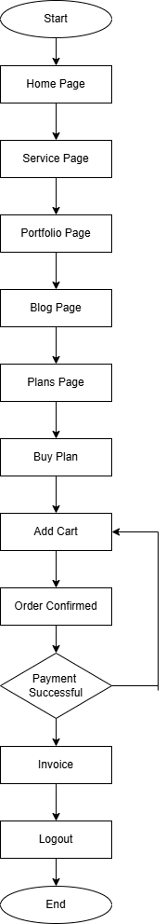
6. Flowchart Diagram (User Side)

Slide 14
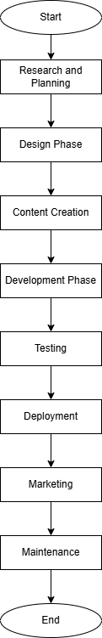
6. Flowchart Diagram (Admin Side)

Slide 15
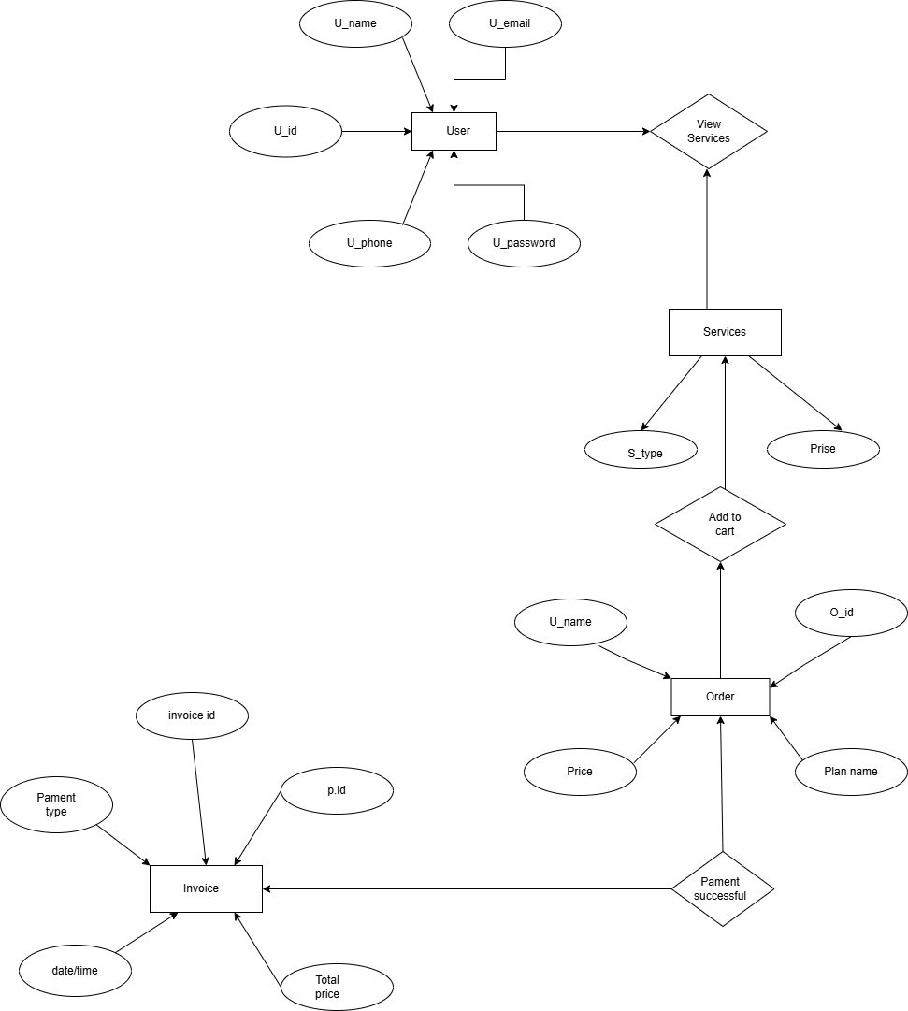
7. E R Diagram

Slide 16
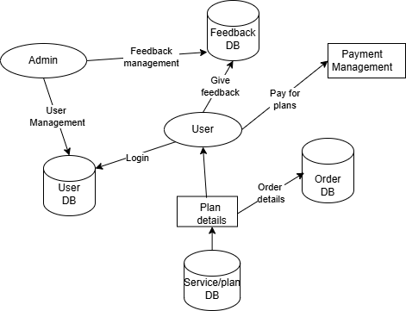
8. DFD Diagram (Level 0)

Slide 17
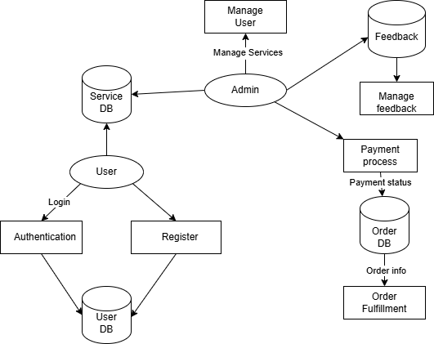
8. DFD Diagram (Level 1)

Slide 18
9.Prototype
Link:-
https://dhyanpatel4670.wixsite.com/hashtaghub

Slide 19
10.Implementation
Front – End: HTML / CSS / JavaScript
Back – End:Php
Database: MySQL

Slide 20
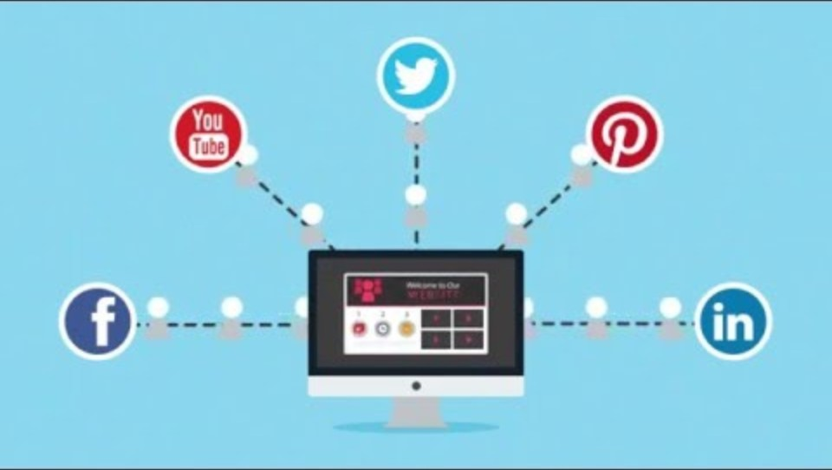
11.Videos

Slide 21
12. Conclusion & Future Works
Conclusion
The digital marketing agency website effectively establishes a strong online presence with user-friendly design, essential features, and SEO optimization. It enhances user experience across devices, supports brand identity, and helps attract and convert leads into clients.
Future Works
Advanced Analytics: Deeper user insights and performance tracking.
AI Chatbot: Real-time visitor assistance.
Multilingual Support: Global audience reach.
SEO Upgrades: Schema markup, voice search optimization.
Social Media Integration: Real-time feeds and sharing.

Slide 22
13. References
Websites & Blogs:
HubSpot Blog
Offers free resources and updates on digital marketing trends.
Neil Patel's Blog
A go-to source for practical SEO, content marketing, and social media strategies.
Tools for Digital Marketing:
Google Analytics - For tracking web traffic and user behaviour.
SEMrush - For SEO, PPC, and keyword research.
Hootsuite - For social media management and analytics.

